Slide 1
COMPOUND ADJECTIVES

Slide 2
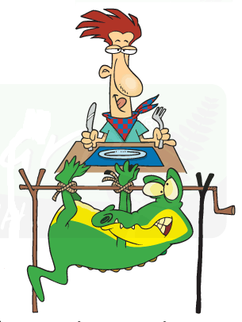
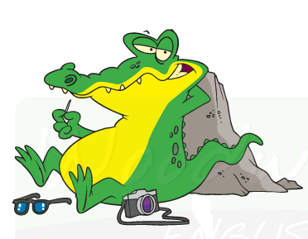
COMPOUND ADJECTIVES
This is a man-eating alligator.
This is a man eating alligator.
The hyphen makes a BIG difference

Slide 3
How do we know when to put a hyphen?
In general we put a hyphen between two or more words (before a noun).
The well-known singer vs. The singer is well known.
The fast-acting medication vs. The medication is fast acting.
A dog-friendly hotel vs. Is this a hotel dog friendly?

Slide 4
How do we know when to put a hyphen?
If you can use the word “and” between the two adjectives or words, then a hyphen isn't necessary.
She has a big blue book – She has a big (AND) blue book
He is a world famous singer – He is a world (AND) famous singer
Hyphen – words work together as a unit of meaning

Slide 5
TYPES OF COMPUND ADJECTIVES
With a Noun and Adjective
last-minute, short-term, high-quality
family-friendly, ice-cold, world-famous
With a Noun, Adjective and Present Participle
time-saving, beautiful-looking, long-lasting
With a Noun, Adjective and Past Participle
wind-powered, water-cooled, old-fashined
With Prepositions
drive-in, worn-out, broken-down

Slide 6
Adverbs before adjectives
Adverbs are often used in conjunction with adjectives, but they are not really considered to be compound adjectives.
They usually do not require a hyphen—the fact that they work together with the adjective is implied.
It was a very brave thing to do.
She is an exceptionally talented girl.

Slide 7
Compound Adjectives with Proper Nouns
A proper noun is the name of something or someone (e.g. Susan Sanders).
Compound Adjectives made from Proper nouns don't need a hyphen though must have capital letters.
I bought the James Jackson tickets for us.
Can you play any Elton John songs?
Did you see the Arthur Miller play on Broadway?

Slide 8
Compound Adjectives with Numbers
Common Error: adding –S
Don’t use -s at the end of compound adjectives with numbers:
Let’s take a ten-minutes break.
Let’s take a ten-minute break.
A car with four wheels is
a four-wheel car.
An animal with four legs is
a four-legged animal.
red-haired, blue-eyed, thin-lipped, left-handed, broad-shouldered, rosy-cheeked

Slide 9
Exercises
1. I have a plant that eats meat.
2. This glue dries quickly.
3. The price of the car was high.
4. Her daughter is twenty-five years old.
I have a meat-eating plant.
This is quick-drying glue.
It was high-priced car.
She has twenty-five-year-old daughter.

Slide 10
Compound adjectives
A walk that takes ten minutes
A report that is thirty pages long
A monster with green eyes
An app that saves time
A woman who has strong will
A lady with a kind heart
Cookies that are free from fat
A documentary that provokes thinking
A ten-minute walk
A thirty-page report
A green-eyed monster
A time-saving app
A strong-willed woman
A kind-hearted lady
Fat-free cookies
A thought-provoking documentary

